Slide 1
Transaction Processing concepts, Concurrency Control and Recovery
PART 2

Slide 2
Objectives of the lecture:
Discuss the two main CC mechanisms:
Locking
Timestamping
Discuss the undesired effects of locking and how to overcome the same

Slide 3
Characterizing Schedules based on Serializability
Practical approach:
Goal: Come up with practical methods (protocols) to ensure serializability.
Concurrency control approaches used in most DBMSs:
Two-phase locking technique – pessimistic approach
Timestamp ordering technique – optimistic approach

Slide 4
Concurrency Control Techniques
Locking Mechanisms
The most common way of achieving serialization
Data that is retrieved for the purpose of updating is locked for the updater
No other user can perform update until unlocked

Slide 5
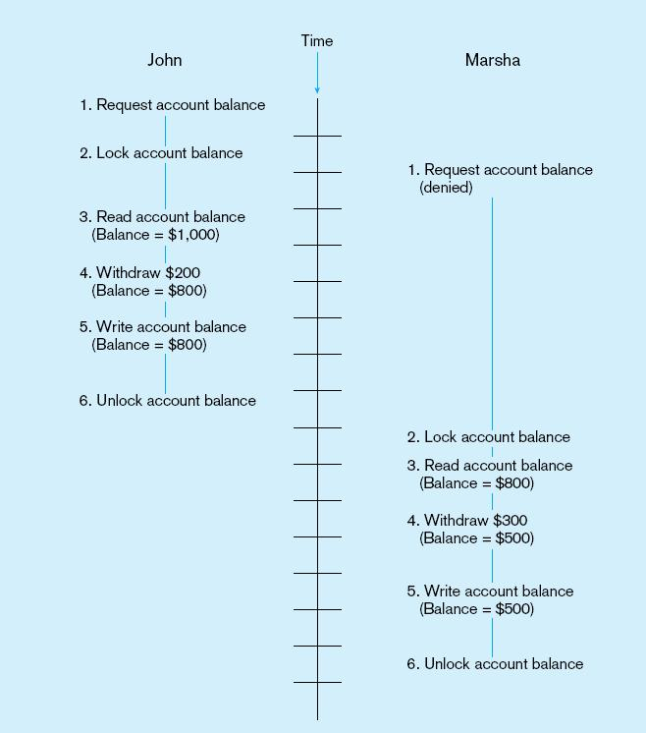
Updates with locking (concurrency control)

Slide 6
Locking Mechanisms
Locking level – Lock Granularity:
Database–used during database updates
Table–used for bulk updates
Block or page–very commonly used
Record–only requested row; fairly commonly used
Field–requires significant overhead; impractical

Slide 7
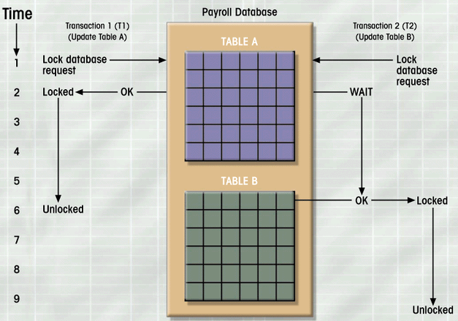
Database Lock

Slide 8
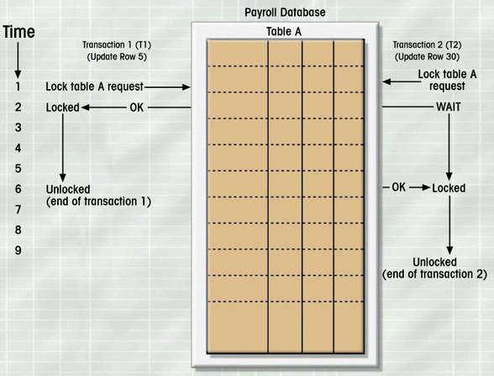
Table Lock

Slide 9
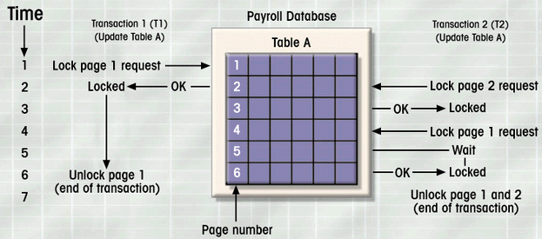
Block or Page Lock

Slide 10
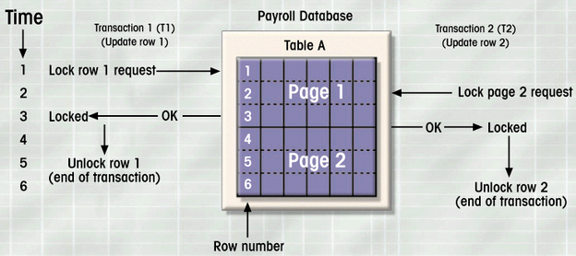
Record Lock

Slide 11
Lock-Based Protocols
A lock is a mechanism to control concurrent access to a data item
Data items can be locked in two modes :
1. exclusive (X) mode. Data item can be both read as well as written. X-lock is requested using lock-X instruction.
2. shared (S) mode. Data item can only be read. S-lock is requested using lock-S instruction.
Lock requests are made to concurrency-control manager. Transaction can proceed only after request is granted.

Slide 12
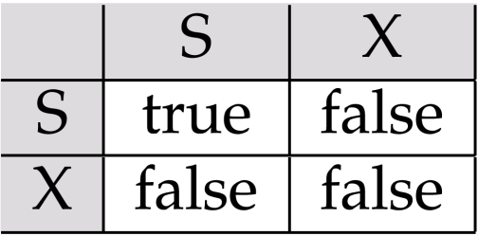
Lock-Based Protocols (2)
Lock-compatibility matrix
A transaction may be granted a lock on an item if the requested lock is compatible with locks already held on the item by other transactions
Any number of transactions can hold shared locks on an item, but if any transaction holds an exclusive on the item no other transaction may hold any lock on the item.
If a lock cannot be granted, the requesting transaction is made to wait till all incompatible locks held by other transactions have been released. The lock is then granted.

Slide 13
Lock-Based Protocols (3)
Example of a transaction performing locking:
T₂: lock-S(A);
read (A);
unlock(A);
lock-S(B);
read (B);
unlock(B);
display(A+B)
Locking as above is not sufficient to guarantee serializability
If A and B get updated in-between the read of A and B, the displayed sum would be wrong. Thus the need for a locking protocol.
A locking protocol is a set of rules followed by all transactions while requesting and releasing locks.
Locking protocols restrict the set of possible schedules.

Slide 14
Two-Phase Locking (2PL)
Two-Phase Locking Protocol
Each X must obtain a S (shared) lock on object before reading, and an X (exclusive) lock on object before writing.
A transaction can not request additional locks once it releases any locks.
If an X holds an X_lock on an object, no other X act can get a lock (S or X) on that object.

Slide 15
The Two-Phase Locking Protocol
The protocol ensures conflict-serializable schedules.
Phase 1: Growing Phase
transaction may obtain locks
transaction may not release locks
Phase 2: Shrinking Phase
transaction may release locks
transaction may not obtain locks
The protocol assures serializability. It can be proved that the transactions can be serialized in the order of their lock points (i.e. the point where a transaction acquired its final lock).

Slide 16
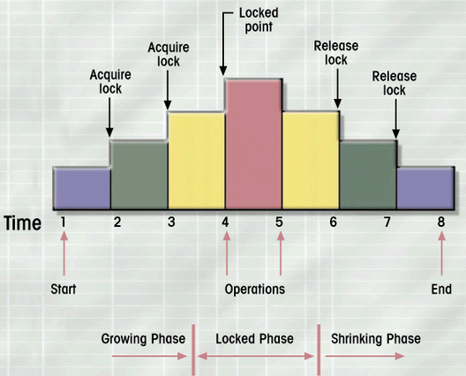
Two-phase locking protocol

Slide 17
The Two-Phase Locking Protocol
Two-phase locking does not ensure freedom from deadlocks
Cascading roll-back is possible under two-phase locking.
To avoid this, follow a modified protocol called strict two-phase locking. Here a transaction must hold all its exclusive locks till it commits/aborts.
Rigorous two-phase locking is even stricter: here all locks are held till commit/abort. In this protocol transactions can be serialized in the order in which they commit.

Slide 18
NB: Lock Conversions
Two-phase locking with lock conversions:
– First Phase - growing:
can acquire a lock-S on item
can acquire a lock-X on item
can convert a lock-S to a lock-X (upgrade)
– Second Phase - shrinking:
can release a lock-S
can release a lock-X
can convert a lock-X to a lock-S (downgrade)
Upgrading takes place in the growing phase and downgrading takes place in the shrinking phase.

Slide 19
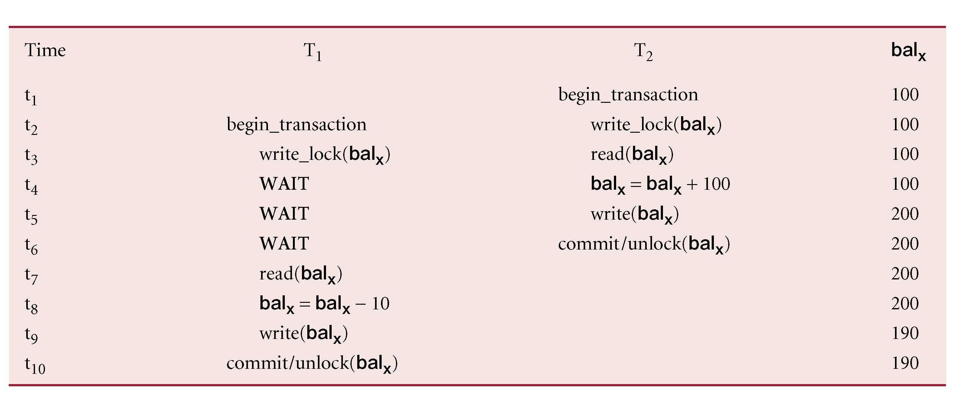
Lost Update-solved

Slide 20
Lost Update – solved(2)
Time | User 1 (Trans A) | User2 (Trans B)
1 | Retrieve t (get S-lock on t)
2 |  | Retrieve t (get S-lock on t)
3 | Update t (request X-lock on t)
4 | wait | Update t (request X-lock on t)
5 | wait | wait
6 | wait | wait
7
No update lost but => deadlock
Notes:
No update is lost but the result is deadlock – see later how to deal with this. Both transactions cannot win, one must be told to rollback (the victim).

Slide 21
Uncommitted Dependency solved
Time | User 1 (Trans A) | User 2 (Trans B)
1 |  | Update t (get X-lock on t)
2 | Retrieve t (request S-lock on t) | -
3 | wait | -
4 | wait | -
5 | wait | Commit / Rollback (releases X-lock on t)
6 | Resume: Retrieve t (get S-lock on t)
7 | -
8
Notes:
A is prevented from seeing change at time t2.
Because transaction B acquires an X-lock on p at time t1, transaction A has to wait until transaction B has either committed or rollbacked.
Transaction A is prevented from seeing an uncommitted change at time t2.
A resolution of the first version of the problem. Second version is similar (check this!).

Slide 22
Inconsistent Analysis ‘solved’
Time | User 1 (Trans A) | User 2 (Trans B)
1 | Retrieve Acc1 : (get S-lock) Sum = 40
2 | Retrieve Acc2 : (get S-lock) Sum = 90
3 |  | Retrieve Acc3: (get S-lock)
4 |  | Update Acc3: (get X-lock) 30 → 20
5 |  | Retrieve Acc1: (get S-lock)
6 |  | Update Acc1: (request X-lock) wait
7 | Retrieve Acc3: (request S-lock) wait | wait wait wait
Notes:
Transaction B’s UPDATE at t6 is not accepted as transaction A holds an S-lock on it.
Inconsistent analysis is prevented but deadlock occurs at time t7.

Slide 23
Pitfalls of Lock-Based Protocols
Locking mechanisms introduces some undesired effect which include:
Waits
Deadlock and
starvation

Slide 24
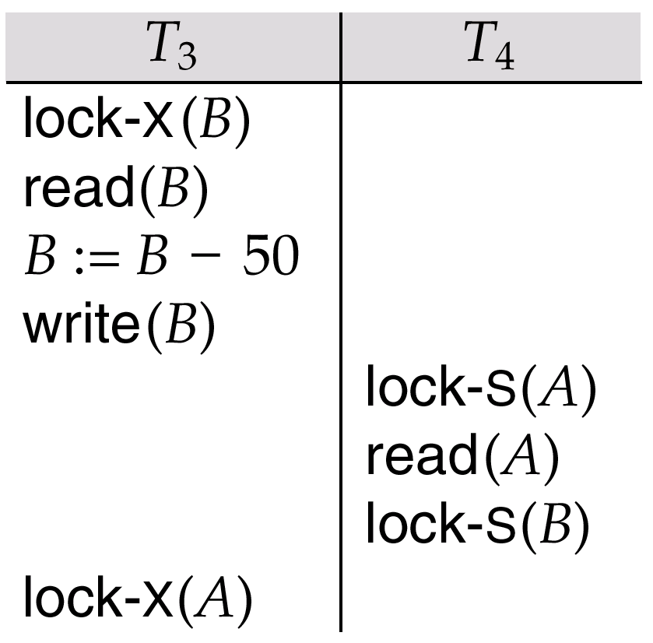
Pitfalls of Lock-Based Protocols
Consider the partial schedule
Neither T₃ nor T₄ can make progress
executing lock-S(B) causes T₄ to wait for T₃ to release its lock on B, while executing lock-X(A) causes T₃ to wait for T₄ to release its lock on A.
Such a situation is called a deadlock.
Generally to handle a deadlock once occurred, one of T₃ or T₄ must be rolled back and its locks released.

Slide 25
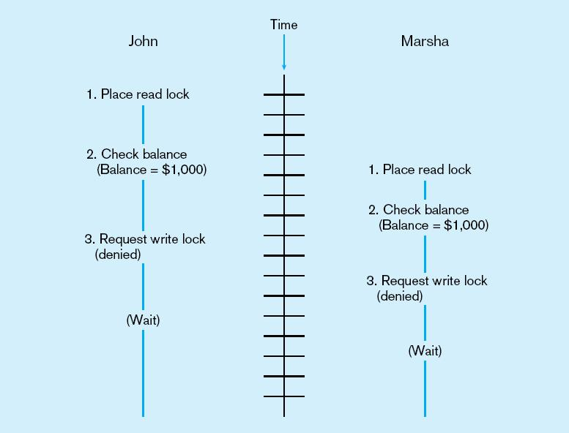
Deadlock
An impasse that may results when two or more transactions have locked common resources, and each waits for the other to unlock their resources
The problem of deadlock
John and Marsha will wait forever for each other to release their locked resources!

Slide 26
Managing Deadlock
Deadlock Prevention (never let it happen):
Conservative two-phase locking protocol
Timestamp techniques:
Wait- Die protocol
Wound – wait protocol
No Wait protocol
Cautiuos-wait protocol
Deadlock Resolution (deal with it after it happens)
deadlock detection using wait-for graph
Time-out schemes

Slide 27
Conservative two-phase locking protocol
Lock all items required at the beginning before it begins execution
If it cannot acquire any lock, release all locks and try again
Deadlock cant occur since there is no hold and wait
Problems
May be difficult to determine all needed resources in advance
Too strict, as it holds locks unnecessarily

Slide 28
Using Timestamps
Scheduler assign each transaction T a unique number, it’s timestamp TS(T).
If T_{i} starts before T_{j} then:
TS(T_{i}) < TS(T_{j}) .
So if one transaction is waiting for another, conflict is resolved on basis of age:
The younger transaction may be aborted and restarted even though there is no proof of a deadlock
Alternative is to check who got the lock first!

Slide 29
Using Timestamps – cont’d
wait-die scheme — non-preemptive
older transaction may wait for younger one to release data item. Younger transactions never wait for older ones; they are rolled back instead
a transaction may die several times before acquiring needed data item
wound-wait scheme — preemptive
older transaction wounds (forces rollback) of younger transaction instead of waiting for it. Younger transactions may wait for older ones.
may be fewer rollbacks than wait-die scheme.

Slide 30
Using Timestamps – cont’d
Both in wait-die and in wound-wait schemes, a rolled back transactions is restarted with its original timestamp. Older transactions thus have precedence over newer ones, and starvation is hence avoided.
Remark on Timeout-Based Schemes :
a transaction waits for a lock only for a specified amount of time. After that, the wait times out and the transaction is rolled back.
thus deadlocks are not possible
simple to implement; but starvation is possible. Also difficult to determine good value of the timeout interval.

Slide 31
Other prevention schemes
No-Wait protocol
Abort a transaction if it can not acquire a lock
Cautious-wait protocol
Allow wait if the transaction holding item is not waiting, otherwise abort.
Remark: all deadlock prevention schemes may kill transactions unnecessarily

Slide 32
Deadlock Detection – Wait-for-graph
Deadlocks can be detected using a wait-for graph, which consists of a pair G = (V,E),
V is a set of vertices (all the transactions in the system)
E is a set of edges; each element is an ordered pair T_{i} →T_{j}.
If T_{i} → T_{j} is in E, then there is a directed edge from T_{i} to T_{j}, implying that T_{i} is waiting for T_{j} to release a data item.
When T_{i} requests a data item currently being held by T_{j}, then the edge T_{i} → T_{j} is inserted in the wait-for graph. This edge is removed only when T_{j} is no longer holding a data item needed by T_{i}.
The system is in a deadlock state if and only if the wait-for graph has a cycle.
Thus DBMS Must invoke a deadlock-detection algorithm periodically to look for cycles.

Slide 33
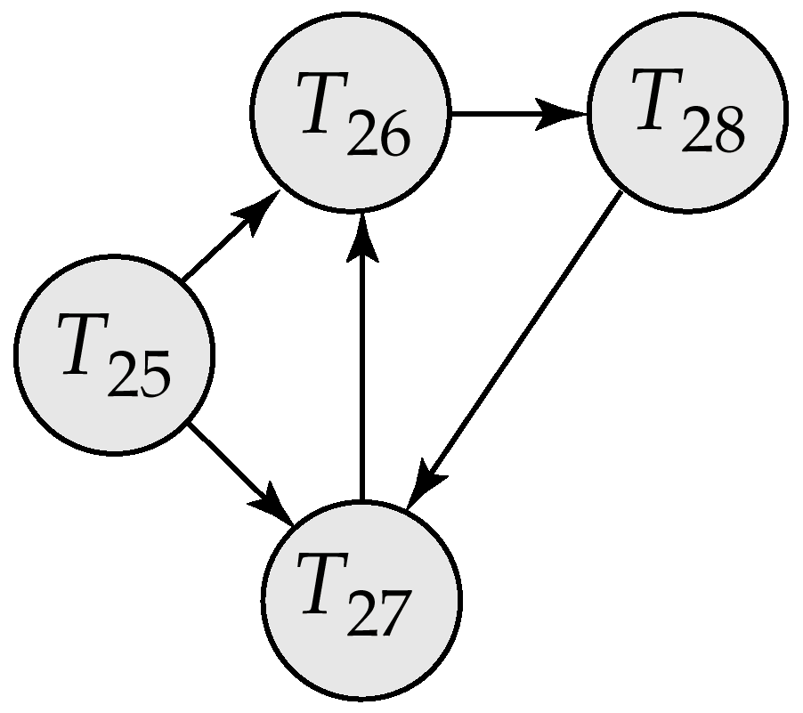
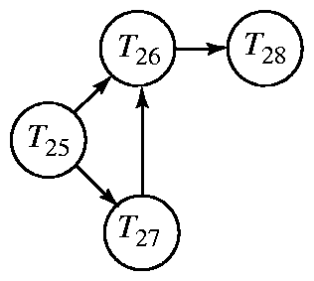
Deadlock Detection (Cont.)
Wait-for graph without a cycle
Wait-for graph with a cycle
DBMS resolve deadlock: One of the transactions is aborted: changes made by the transaction up to the time of deadlock are removed & transaction is restarted when the required resources become available.

Slide 34
Deadlock Detection (Cont.)
Timeout protocol
If a transaction waits longer than a specified amount of time, it gets aborted.
Here deadlock is only assumed, not proved

Slide 35
Starvation
Starvation occurs when a transaction can not make any progress for an indefinite period of time, while other transactions proceed.
Starvation happens if same transaction is always chosen as victim – thus the need to Include the number of rollbacks in the cost factor to avoid starvation
Starvation also happens if waiting protocol is unfair; uses stacks instead of queues!

Slide 36
Other Pitfalls of Lock-Based Protocols
Lock management overhead.
Concurrency is significantly lowered, when congested nodes are locked.
(Most Important) Conflicts are rare. (We might get better performance by not locking, and instead checking for conflicts at commit time.)

Slide 37
What is Timestamping?
Scheduler assign each transaction T a unique number, it’s timestamp TS(T).
Timestamps must be issued in ascending order, at the time when a transaction first notifies the scheduler that it is beginning.
Each transaction is issued a timestamp when it enters the system. If an old transaction T_{i} has time-stamp TS(T_{i}), a new transaction T_{j} is assigned time-stamp TS(T_{j}) such that TS(T_{i}) <TS(T_{j}).
The protocol manages concurrent execution such that the time-stamps determine the serializability order.

Slide 38
Timestamp TS(T)
Two methods of generating Timestamps.
Use the value of system, clock as the timestamp.
Use a logical counter that is incremented after a new timestamp has been assigned.
Scheduler maintains a table of currently active transactions and their timestamps irrespective of the method used

Slide 39
Timestamps for database element X and commit bit
RT(X):- The read time of X, which is the highest timestamp of transaction that has read X.
WT(X):- The write time of X, which is the highest timestamp of transaction that has written X.
C(X):- The commit bit for X, which is true if and only if the most recent transaction to write X has already committed.

Slide 40
Rules for Timestamps-Based scheduling
1. Scheduler receives a read request; RT(X)
a) If it’s timestamp TS(T). TS(T) ≥ WT(X), the read is physically realizable.
i. If C(X) is true, grant the request,
if TS(T) > RT(X),
set RT(X) := TS(T);
otherwise do not change RT(X).
ii. If C(X) is false, delay T until C(X) becomes true or transaction that wrote X aborts.
b) If TS(T) < WT(X), the read is physically unrealizable. Rollback T.

Slide 41
Rules for Timestamps-Based scheduling (Cont.)
2. Scheduler receives a write request; WT(X).
a) if TS(T) ≥ RT(X) and TS(T) ≥ WT(X), write is physically realizable and must be performed.
i. Write the new value for X,
ii. Set WT(X) := TS(T), and
iii. Set C(X) := false.
b) if TS(T) ≥ RT(X) but TS(T) < WT(X), then the write is physically realizable, but there is already a later value in X.
i. If C(X) is true, then the previous writers of X is committed, ignore the write by T.
ii. If C(X) is false, we must delay T.
c) if TS(T) < RT(X), then the write is physically unrealizable, and T must be rolled back.

Slide 42
Rules for Timestamps-Based scheduling (Cont.)
3. Scheduler receives a request to commit T. It must find all the database elements X written by T and set C(X) := true. If any transactions are waiting for X to be committed, these transactions are allowed to proceed.
4. Scheduler receives a request to abort T or decides to rollback T, then any transaction that was waiting on an element X that T wrote must repeat its attempt to read or write.

Slide 43
Correctness of Timestamp-Ordering Protocol
The timestamp-ordering protocol guarantees serializability since all the arcs in the precedence graph are of the form:
Thus, there will be no cycles in the precedence graph
Timestamp protocol ensures freedom from deadlock as no transaction ever waits.
But the schedule may not be cascade-free, and may not even be recoverable.
transaction
with larger
timestamp
transaction
with smaller
timestamp

Slide 44
Timestamps and Locking
Generally, timestamping performs better than locking in situations where:
Most transactions are read-only.
It is rare that concurrent transaction will try to read and write the same element.
In high-conflict situation, locking performs better than timestamps

Slide 45
Other methods used for CC
Multiple granularity locking
Versioning
Multi-versioning
graph-based methods .e.g. the tree-locking protocol
Read and make notes on the same!

